Slide 1
Hacker Techniques, Tools, and Incident Handling
Chapter 9
Web and Database Attacks

Slide 2
Learning Objective
Perform system hacking, and web and database attacks.

Slide 3
Key Concepts
Web server vulnerabilities, tools, and exploits
Web application vulnerabilities, tools, and exploits
Database attacks and attack tools

Slide 4
Attacking Web Servers
Classes of individuals interacting or concerned with web server
Server administrator
Network administrator
End user
Notes:
Server administrator — Concerned with the security of the server because it can act as the entry point into the network for malicious code, such as viruses, worms, Trojans, and rootkits. Has become even more of a challenge because web servers have become increasingly complex and feature rich, with unknown or undocumented options that are left unaddressed.
Network administrator — Concerned with the fallout from the problems the server administrator may introduce or overlook. These security problems can lead to holes that can be exploited to gain access to the company network and the services hosted on other connected servers. These administrators are aware that a web server needs to be usable by the public and therefore accessible to the masses and at the same time secure (which can conflict with the former goal).
End user — As the individual who will work the most with the server, concerned mostly with access to content and services. Regular users just want to browse a site and access their desired content; they do not think about things like Java, Flash, and ActiveX and the very real security threats they may be introducing to their system. Making this more of an issue is the simple fact that the web browser they are using to access this content can allow threats to bypass their or the company’s firewall and have a free ride into the internal network.

Slide 5
Attacking Web Servers (Cont.)
Categories of risk
Defects and misconfiguration risks
Browser- and network-based risks
Browser or client-side risks
Vulnerabilities of web servers
Improper or poor web design
Can sometimes observe sensitive items by viewing the source code of the page
Notes:
Server defects and misconfiguration risks — Risks include the ability to steal information from a server, run scripts or execute remotely or carry out Denial of Service (DoS) attacks.
Browser- and network-based risks — Include scenario where an attacker captures network traffic between the client (web browser) and server.
Browser or client-side risks — Risks that affect the user’s system directly, such as crashing the browser, stealing information or infecting the client’s system
Vulnerabilities of web servers — Includes same vulnerabilities as other servers plus vulnerabilities associated with hosting content.
Improper or poor web design — Attackers can observe hidden tags that are placed in a webpage by a web designer by viewing the source code.

Slide 6
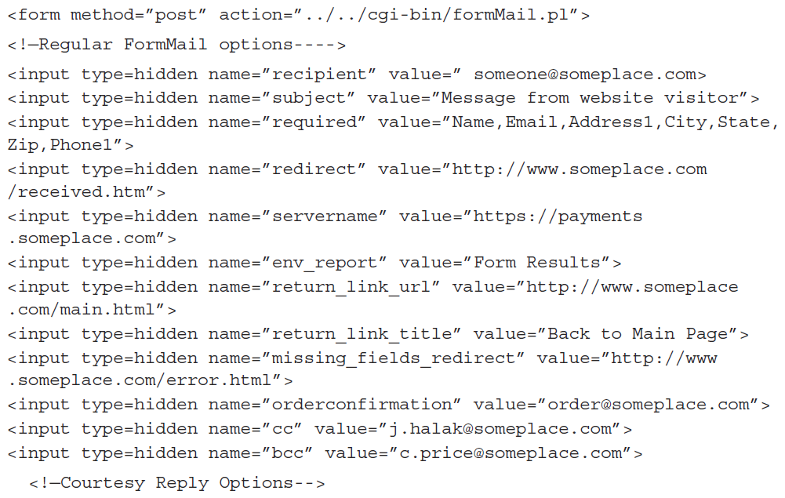
Source Code Example 1
Notes:
In the code, notice the presence of email addresses and even the presence of what appears to be a payment processing server (https://payments.someplace.com). This is information that can be used to target an attack.

Slide 7
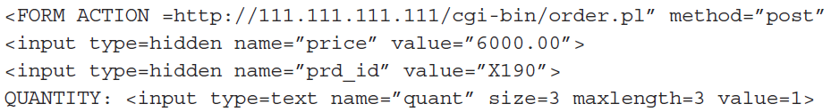
Source Code Example 2
Web designer used hidden fields to hold the price of an item
Unscrupulous attackers could change the price of the item from $6000 to $60 and make their own discount

Slide 8
Web Server Vulnerabilities
p.217
Buffer overflow
Denial of service (DoS) attack
Distributed denial of service (DDoS) attack
Banner information
Permissions
Error messages
Unnecessary features
User accounts
Structured Query Language (SQL) injections

Slide 9
Buffer Overflow
Buffer overflow occurs when an application, process, or program attempts to put more data in a buffer than it was designed to hold
A programmer, either through lazy coding or other practices, creates a buffer in code but does not put restrictions on it
Like too much water poured into an ice cube tray, the data must go someplace, which in this case means adjacent buffers
Can result in corrupted or overwritten data, loss of system integrity, or the disclosure of information to unauthorized parties
Notes:
https://www.youtube.com/watch?v=1S0aBV-Waeo
Watch this Buffer Overflow Video.

Slide 10
Denial of Service (DoS)/DDoS Attacks
DoS
An attack in which all web server resources are rapidly consumed, slowing the performance of a server
Is mostly considered an annoyance
DDoS
Accomplishes the same goal as DoS; the difference is scale
Many more systems are used to attack a target, crushing it under the weight of multiple requests at once

Slide 11
Examples of DDoS Attacks
Ping flooding attack
Smurf attack
SYN flooding
Internet Protocol (IP) fragmentation/fragmentation attack
Notes:
Ping flooding attack — A computer sends a ping to another system with the intention of uncovering information about the system. This attack can be scaled up so that the packets being sent to a target will force the system to go offline or suffer slowdowns.
Smurf attack — Similar to the ping flooding attack but with a twist to the process. In a Smurf attack, a ping command is sent to an intermediate network, where it is amplified and forwarded to the victim. This single ping now becomes a virtual tsunami of traffic.
SYN flooding — The equivalent of sending a letter that requires a return receipt. However, the return address is bogus. If a return receipt is required and the return address is bogus, the receipt will go nowhere, and a system waiting for confirmation will be left in limbo for some period of time. An attacker that sends enough SYN requests to a system can use all the connections on a system so that nothing else can get through.
Internet Protocol (IP) fragmentation/fragmentation attack — Requires an attacker to use advanced knowledge of the Transmission Control Protocol/Internet Protocol (TCP/IP) suite to break up packets into “fragments” that can bypass most intrusion detection systems (IDSs). In extreme cases, this type of attack can cause service or system freezes, lockups, reboots, blue screens, and other mischief.

Slide 12
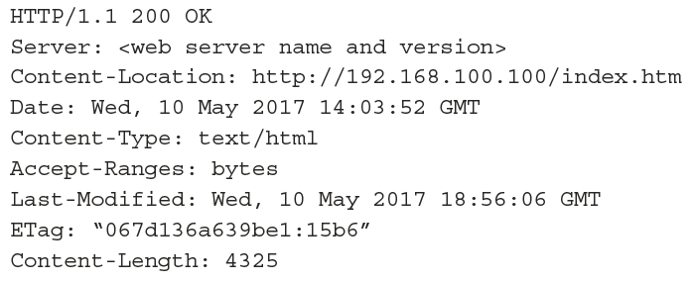
Banner Information
A banner reveals information about a web server
Connect to port 80 (HTTP) on a web server to receive web server’s banner; for example:
telnet www.<servername>.com 80
Results:
Notes:
Webmasters can sanitize header information

Slide 13
Permissions
Permissions:
Control access to a server and its content
Can easily be incorrectly configured
Incorrectly assigned permissions:
Have potential to allow access to locations on web server that should not be accessible
Older web servers allowed access to directory traversal by default
An attacker could enter a path, such as “../../../etc/somefile”, and access files in other directories

Slide 14
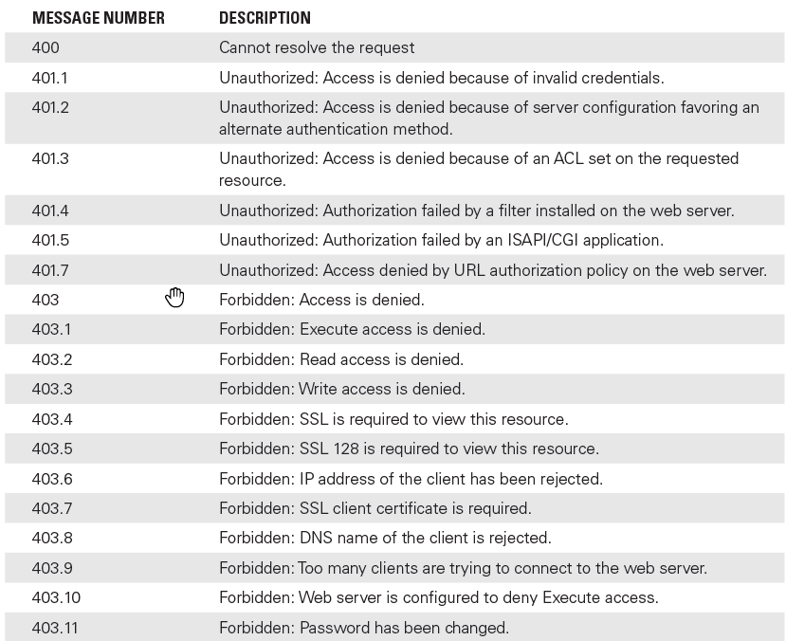
Error Messages
Error messages can be a potential vulnerability and give vital information to an attacker
Internet Information Services (IIS) messages:
Notes:
Error messages should be configured to be descriptive during development and testing, but when deployed into a production environment they should be sanitized (made generic). They should provide enough information for users to understand what to do next but not divulge information to attackers.

Slide 15
Unnecessary Features
Servers should be purpose-built to the role they will fill in the organization
Anything not essential to this role should be eliminated
Hardening removes features, services, and applications that are not necessary for a system to do its appointed job
If a feature or service is not needed, it should be disabled or, better yet, uninstalled
Notes:
Everything that is running on a system, such as services, applications, or processes, can be targeted and exploited by an attacker.
Shutting off unnecessary features reduces the attack surface of the server.

Slide 16
User Accounts
Most operating systems come preconfigured with user accounts and groups already defined and in place
These accounts can easily be discovered through research by an attacker
Uses accounts to gain access to the system
Security best practices
Disable or remove default accounts
Create new ones that correspond to how an administrator will use the service

Slide 17
SQL Basics
https://www.youtube.com/watch?v=bEtnYWuo2Bw 10 minute video to give you a little foundation of what SQL is. This will be helpful for next week’s lab on SQL Injection.
Khan Academy series for those who want to know more:
https://www.khanacademy.org/computing/computer-programming/sql/sql-basics/v/welcome-to-sql

Slide 18
Structured Query Language (SQL) Injections
Designed to exploit “holes” in a web application
Attacker injects SQL code into input box, form, or network packet
SQL commands can exploit nonvalidated input vulnerabilities
Used to execute arbitrary SQL commands through web applications

Slide 19
Examining a SQL Injection
If a website lacks input validation, only a web browser and SQL knowledge are needed to launch an attack
SQL injection attack:
Is a common and serious issue with websites that use a database as its back end
Is carried out by placing special characters into existing SQL commands and modifying behavior to achieve desired result

Slide 20
Examining a SQL Injection (Cont.)
In the following example, after an attacker with the username “kirk” inputs the string ‘name’; DELETE FROM items;-- ‘ for itemname, the query becomes the following two queries:
SELECT * FROM items
WHERE owner= ‘kirk’
AND itemname= ‘name’;
DELETE FROM items;--‘

Slide 21
Examining a SQL Injection (Cont.)
If an attacker enters the string ‘name’; DELETE FROM items; SELECT * FROM items WHERE ‘a’=’a’;, the following valid statements will be created:
SELECT FROM items
WHERE owner=’kirk’
AND itemname= ‘name’;
DELETE FROM items;
SELECT * FROM items WHERE ‘a’= ‘a’;
Notes:
A good way to prevent SQL injection attacks is to use input validation, which ensures that only approved characters are accepted. Use whitelists, which dictate safe characters, and blacklists, which dictate unsafe characters. Because one attack point is during the transmission to the server, it is necessary to validate all input received on the server even if the initial input was validated on the client. Complete server validation is the only way to trust data.
Additionally, most implementations of SQL support stored procedures. Web application developers can use prewritten stored procedures and pass data as parameters instead of just passing SQL queries. Using stored procedures can make successful SQL injection attacks much harder to carry out.

Slide 22
Cross-Site Scripting (XSS) Attack
The attacker discovers that the HYRULE website suffers from an XSS scripting defect.
An attacker sends an email stating that the victim has just been awarded a prize and should collect it by clicking a link in the email.
The link in the email goes to http://www.hyrule.com/default.asp?name= <script>badgoal()</script>.
When the user clicks the link, the website displays the message “Welcome Back!” with a prompt to enter the name.
Notes:
Cross-site scripting (XSS) attack. It relies on a variation of the input validation attack, but the target is different because the goal is to go after a user instead of the application or data. An example of an XSS attack uses scripting methods to execute a Trojan horse with a target’s web browser; this would be made possible using scripting languages, such as JavaScript or PHP.

Slide 23
Cross-Site Scripting (XSS) Attack (Cont.)
The website has the name from your browser via the link in the email. When the link was clicked in the email, the HYRULE website was told your name is <script>evilScript () </script>.
The web server reports the “name” and returns it to the victim’s browser.
The browser correctly interprets this as script and runs it.
This script instructs the browser to send a cookie containing some information to the attacker’s system, which it does.

Slide 24
Anatomy of Web Applications
Exploitative Behaviors
Theft of information, such as credit cards or other sensitive data
The ability to update application and site content
Server-side scripting exploits
Buffer overflows
Domain Name System (DNS) attacks
Destruction of data

Slide 25
Anatomy of Web Applications (Cont.)
Categories of web application vulnerabilities
Authentication issues
Authorization configuration
Session management issues
Input validation
Encryption strength and implementation
Environment-specific problems
Notes:
Common vulnerabilities with web applications tend to be somewhat specific to the environment, including factors such as operating system, application, and user base.

Slide 26
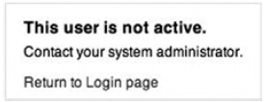
Insecure Logon Systems
Exam of a revealing error message:
Track information relating to improper or incorrect user logons
Entry of an invalid user ID with a valid password
Entry of a valid user ID with an invalid password
Entry of an invalid user ID and password
Notes:
Applications should be designed to return very generic information that does not reveal information such as correct usernames. Web apps that return messages such as “username invalid” or “password invalid” can give an attacker a target to focus on—such as a correct password.
p225 – Brutus and THC-Hydra are utilities/tools designed to uncover and crack passwords for web applications and websites.

Slide 27
Scripting Errors
Upload bombing
Poison null byte attack
Default scripts
Sample scripts
Poorly written or questionable scripts
Notes:
Upload bombing — Upload bombing uploads masses of files to a server with the goal of filling up the hard drive on the server. Once the hard drive of the server is filled, the application will cease to function and crash.
Poison null byte attack — A poison null byte attack passes special characters that the scripts may not be designed to handle properly. When this is done, the script may grant access where it should not otherwise be given.
Default scripts — Default scripts are uploaded to servers by web designers who do not know what they do at a fundamental level. In such cases, an attacker can analyze or exploit configuration issues with the scripts and gain unauthorized access to a system.
Sample scripts — Web applications may include sample content and scripts that are regularly left in place on servers. In such situations, these scripts may be used by an attacker to carry out mischief.
Poorly written or questionable scripts — Some scripts have appeared that include information such as usernames and passwords, potentially letting an attacker view the contents of the script and read these credentials.

Slide 28
Session Management Issues
Session
Represents connection that a client has with the server application
Session information can give an attacker access to confidential information
Session will have:
Unique identifier
Encryption
Other parameters
Notes:
Ideally, a session will have a unique identifier, encryption, and other parameters assigned every time a new connection between client and server is created. After the session is exited, closed, or not needed, the information is discarded and not used again (or at least not used for an extended period of time), but this is not always the case.

Slide 29
Session Vulnerabilities
Long-lived sessions
Logout features
Insecure or weak session identifiers
Granting session IDs to unauthorized users
Absent or inadequate password change controls
Inclusion of unprotected information in cookies
Notes:
Long-lived sessions — Sessions between client and server should remain valid only for the length they are needed and then discarded. Sessions that remain valid for periods longer than they are needed allow attackers using attacks such as XSS to retrieve session identifiers and reuse a session.
Logout features — Applications should provide a logout feature that allows a visitor to log out and close a session without closing the browser.
Insecure or weak session identifiers — Session IDs that are easily predicted or guessed can be used by an attacker to retrieve or use sessions that should be closed. Some flaws in web applications can lead to the reuse of session IDs.
Granting session IDs to unauthorized users — Sometimes applications grant session IDs to unauthenticated users and redirect them to a logout page. This can give the attacker the ability to request valid URLs.
Absent or inadequate password change controls — An improperly implemented or insecure password change system, in which the old password is not required, allows a hacker to change passwords of other users.
Inclusion of unprotected information in cookies — Information such as the internal IP address of a server that can be used by a hacker to ascertain more about the nature of the web application

Slide 30
Encryption Weaknesses
Weak ciphers
Use short keys or are poorly designed and implemented
Vulnerable software
Software implementations (such as Secure Sockets Layer [SSL]) may have poor programming
Allows attacker to decrypt data easily and gain unauthorized access
Notes:
When working on securing web applications, you must consider the safety of information at two stages: when it is being stored and when it is transmitted. Both stages are potential areas for attack and must be considered thoroughly by the security professional.
Some tools and resources are available that can help in assessing the security of web applications and their associated encryption strategies:
OpenSSL, an open-source toolkit used to implement the SSLv3 and Transport Layer Security (TLSv1) protocols (www.openssl.org)
The Open Web Application Security Project (OWASP) Guide to Cryptography (www.owasp.org/index.php/Guide_to_Cryptography)
Nessus security scanner, which can list the ciphers in use by a web server (www.tenable.com/products/nessus-vulnerability-scanner)
Stunnel, a program that allows the encryption of non-SSL–aware protocols (www.stunnel.org)

Slide 31
Database Vulnerabilities
Contains info about the site or application
Configuration info, application data, and other data
“Holy grail” to attackers
Notes:
Databases lie at the heart of many well-known web applications, such as Microsoft’s SharePoint. In fact, a majority of web applications would not function without a database as their back end.

Slide 32
Database Types
Relational database
Data can be organized and accessed to fit the scenario
Nonrelational / NoSQL database
Come in different varieties
Data is stored as a collection of tables and accessed through a query language such as SQL
Key-value store is popular
NoSQL data stores (Hadoop and Cassandra) grew from need to store and retrieve large volumes of data in short periods of time
Notes:
a database can be boiled down into a very simple concept: a structured format for storing information for later retrieval, modification, management, and other purposes.
Within a relational database are several structures designed to organize information. Each structure allows the data to be easily managed, queried, and retrieved:
Record/row/tuple—Each record in a database represents a collection of related data, such as information about a person.
Column/field/attribute—A column represents one type of data, for example, age data, for each person in the database.
one of the higher-profile targets, is in membership or member registration sites. In these types of sites, information about visitors who register with the site is stored within a database = PII.

Slide 33
Database Vulnerabilities
Misconfiguration
Lack of training
Buffer overflows
Forgotten options
Other oversights

Slide 34
Locating Databases on the Network
Network Database Scanner
Effective at locating “rogue” or unknown database installations
SQLRecon
Similar to Network Database Scanner
For Microsoft SQL installations
Oscanner
For Oracle installations
Notes:
Network Database Scanner can scan a network for running database servers for MySQL, Microsoft SQL Server, Oracle, IBM DB2, or PostgreSQL. It attempts to detect any services that are running on the standard ports for each supported database product. Because of the proliferation of personal firewalls, inconsistent network library configurations, and multiple-instance support, database installations are becoming increasingly difficult to discover, assess, and maintain. Having a tool handy that can detect running database servers helps keep administrators up to date as to what is actually running on their environments.

Slide 35
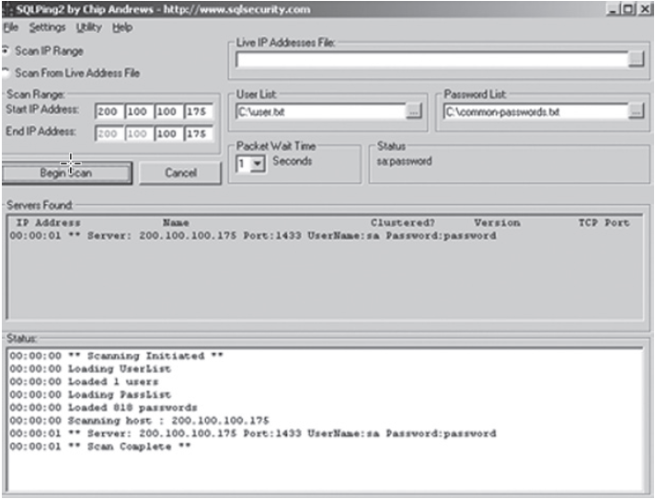
Network Database Scanner

Slide 36
Database Server Password Cracking
Password cracking tools
SQLPing3
Cain and Abel
Dictionary-based cracking methods

Slide 37
Locating Vulnerabilities in Databases
Common vulnerabilities include:
Used stored procedures
Services account privilege issues
Weak or poor authentication methods enabled
No or limited audit log settings
Notes:
p. 230
Three software tools that are useful for performing audits on databases are NCC SQuirreL, AppDetectivePro, and Scuba:
Scuba is freeware.
AppDetectivePro: includes built-in templates to satisfy the requirements of security best practices and many regulatory compliance initiatives, including National Institute of Standards and Technology (NIST) 800-53 (the Federal Information Security Management Act [FISMA]), the Payment Card Industry Data Security Standard (PCI DSS), the Health Insurance Portability and Accountability Act (HIPAA), the Gramm-Leach-Bliley Act (GLBA), and the Sarbanes-Oxley Act (SOX).

Slide 38
Out of Sight, Out of Mind
Learn the security features in the database system
Keep up to date
Use a firewall
Evaluate the use of nonstandard ports
Secure the operating system
Notes:
Learn the provided security features in the database system—Protect the stability of the database and its surrounding applications by evaluating the use of what is known as process isolation. Process isolation provides extra protection against catastrophic failure of a system by ensuring that one process crashing will not take others with it.
Evaluate the use of nonstandard ports—Some applications must run on standard ports, such as 1433 for SQL Server. If your application does not require a specific port, consider changing it to one that is not commonly looked for or is unusual, making an attacker have to do more work.
Keep up to date—Keep on top of the patches and service packs that are made available for your system. Apply the patches where appropriate to ensure that you do not become a victim of a bug or defect that has already been addressed.
Secure the OS —The database doesn’t live on an island someplace by itself. It is installed on an operating system, which has its own layers of protection to offer. Ensure that the operating system in use always has the latest patches and service packs installed.
Use a firewall—Always use a firewall to protect your database servers (and any valuable network resources). A good firewall can provide tremendous protection to a database server, reducing the likelihood of a successful attack against it.

Slide 39
Cloud Computing
Cloud service models: Platform as a Service (PaaS), Software as a Service (SaaS), and Infrastructure as a Service (IaaS)
Security issues:
Availability
Reliability
Loss of control
Notes:
Availability — Because the environment is offsite and accessed by an Internet connection, any Internet outages would affect accessibility of services.
Reliability — Because the services is in another’s hands, subscribers may find themselves at the whims of the vendor. Cloud service providers invest heavily to ensure minimum uptime guarantees.
Loss of control — When services and other items are hosted internally, the company is in control of the stability of its environment. When these services move offsite, control of resources is decreased because it is handled by another party.

Slide 40
Cloud Services, cont...
Infrastructure as a Service (IaaS)
A cloud service in which the service consists of a virtual machine that has defined computing resources (CPUs, RAM, disk, and network), and may or may not be provided with an installed OS.
Software as a Service (SaaS)
A cloud service in which the service consists of access to working software, without the need to be concerned about the details of installing and maintaining the software or the servers on which it runs.
Platform as a Service (PaaS) - (Development)
A cloud service intended for software developers as a development platform, with a variety of tools useful to developers already installed, so that the developer can focus on developing software rather than on creating a good development environment.
PaaS VMs often include an integrated development environment (IDE), which is a set of related tools that enables the developer to write and test code easily.

Slide 41
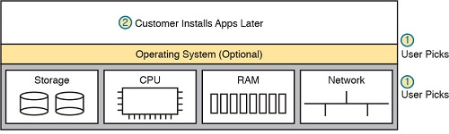
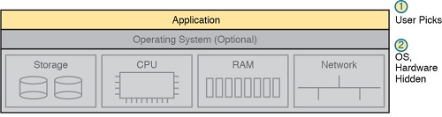
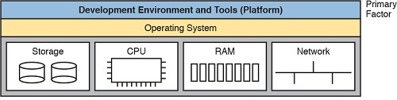
Cloud Services - visualized
Figure 27-11: SaaS Concept
Figure 27-12: PaaS Concept

Slide 42
Summary
Web server vulnerabilities, tools, and exploits
Web application vulnerabilities, tools, and exploits
Database attacks and attack tools

